Slide 1
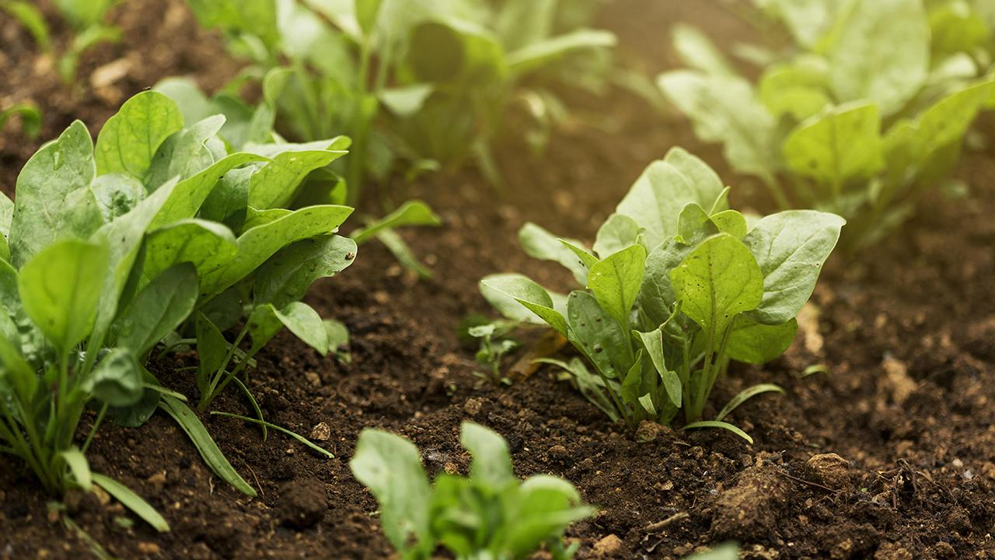
AgroSphere
Forecast, Diagnose, and Collaborate – All in One Platform

Slide 2
Problem Statement
Farmers often face unpredictable weather, unidentified crop diseases, and lack of access to shared tools or equipment,so there is smart site where farmer can get helped by interacting with site in their native language.

Slide 3
Solution Overview
Weather forecast
01
7-day weather forecast
Disease identification
02
Crop disease identification
Resource sharing
03
Farmers-to-farmers can share their resources in a community
Price Prediction
04
Mandi/market price prediction
Support Multi language
05
Language is understand by ungraduated farmer

Slide 4

01
Weather Forecast Feature

Slide 5

Weather forecasting
Real-time, location-based 7-day weather forecast.
Helps farmers plan irrigation, fertilization, and harvesting.

Slide 6
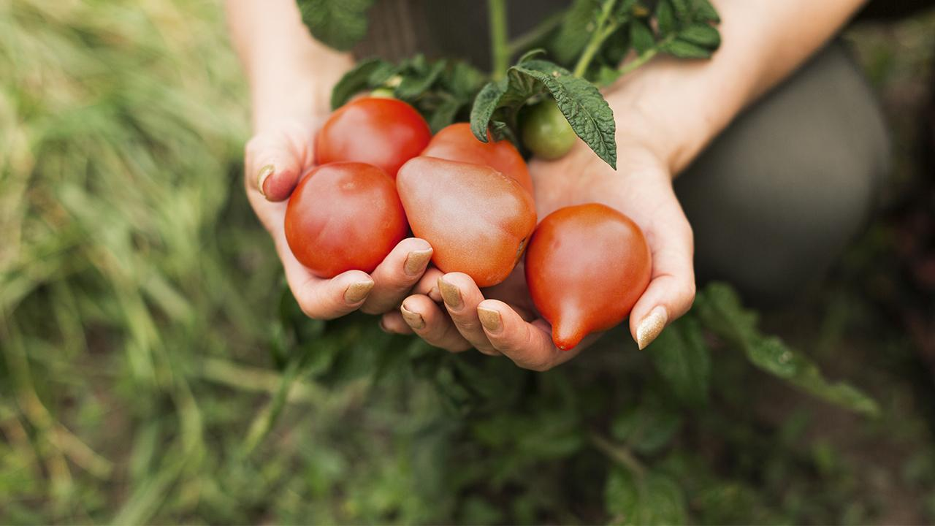
02. Crop Disease Detection

Slide 7

About disease detection
Farmers can upload images of affected crops.
AI-powered analysis provides diagnosis and suggests treatments.

Slide 8
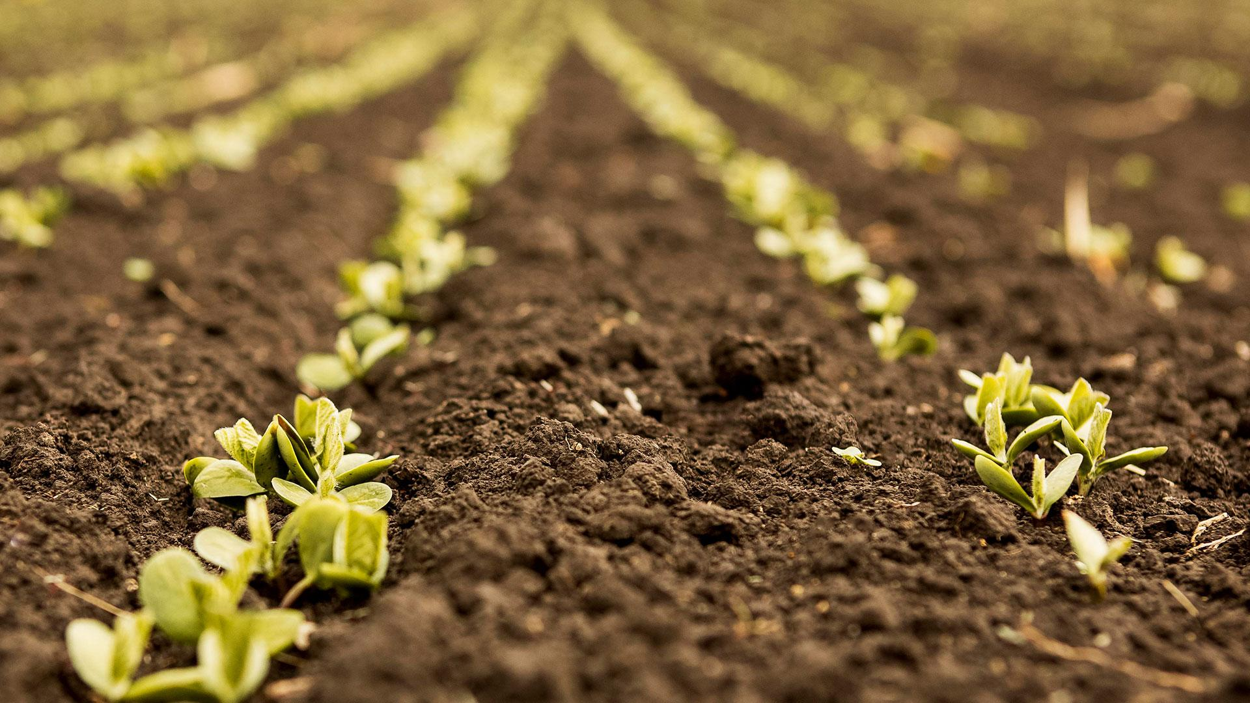
03
Farmer Community Feature

Slide 9

Community features
Post requests for tools/machinery
Specify usage duration and offer price
Other farmers can accept requests.

Slide 10

04
Price Prediction

Slide 11
Mandi Price Prediction
It’s about forecasting the future prices of crops (like wheat, rice, cotton, etc.) in local markets (mandis) based on data trends. It helps farmers decide when and where to sell their produce.

Slide 12
Support Multi language
05

Slide 13
Support Multi language
The website includes an AI-based chatbot that supports multiple languages.
Helps farmers interact easily in their native language
Provides weather info, disease tips, and community support
Increases accessibility and user engagement

Slide 14
- Improved crop yield through timely weather updates - Reduced losses with early disease detection - Cost-saving through shared resources
Benefits

Slide 15
Future scope
In future we provide real time weather alerts
SMS alert for instant hike in market or
Fall in market
AI ML model for price prediction and disease prediction can be improved

Slide 16
Thanks!

